Slide 1
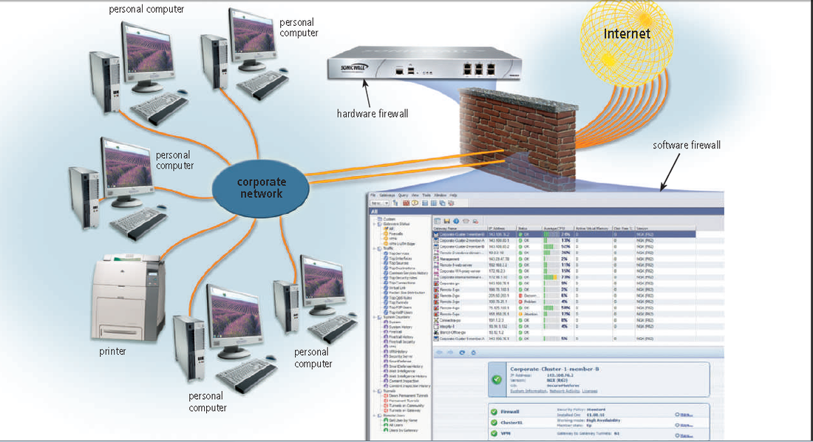

Slide 2

FIREWALL
Firewall can block packets between the private and the public network avoiding lack of informations, providing a safe access to the internet and protecting by cyber attacks.
Firewall can deny the access to websites as well, like unsafe sources or pornographic contents.

Slide 3
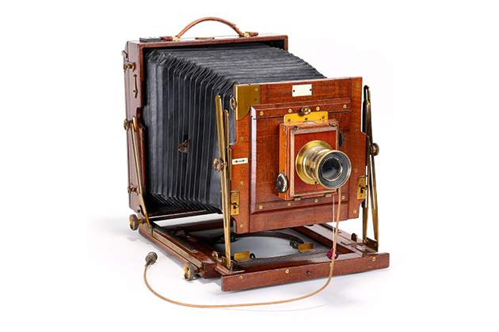
THE STORY OF PORNOGRAPHY: the new art after the invention of the photo during the Belle Époque
In France the invention of the camera and the spread of this new technology, during the Belle Époque, bring the art’s experimentation to new borders.
The use of painting naked body influenced the newborn art: the photography and later on the cinema

Slide 4
Differences between nude – erotic -porn
There is a thin line that separates these three concepts that very often is misunderstood:
NUDE
EROTIC
PORN
It’s the portrayal of sexual subject matter for the exclusive purpose of sexual arousal
It’s the representation of human body for anatomic purposes
It’s making art with provocative subjects that causes sexual feelings

Slide 5
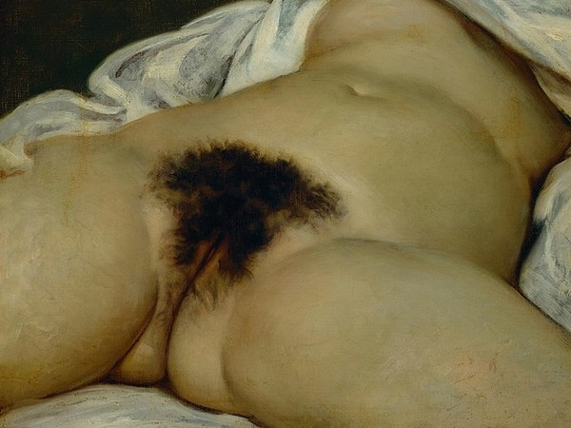
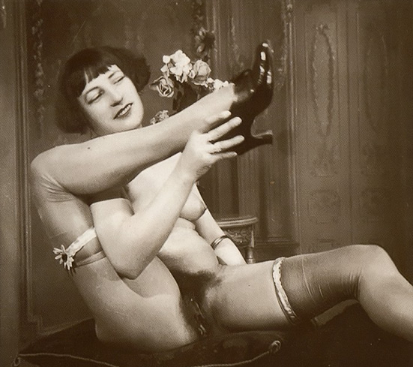
“L’Origine Du Monde”, Gustave Courbert – 1866
Oil painting on canvas
Naked woman, anonymous
Photo

Slide 6
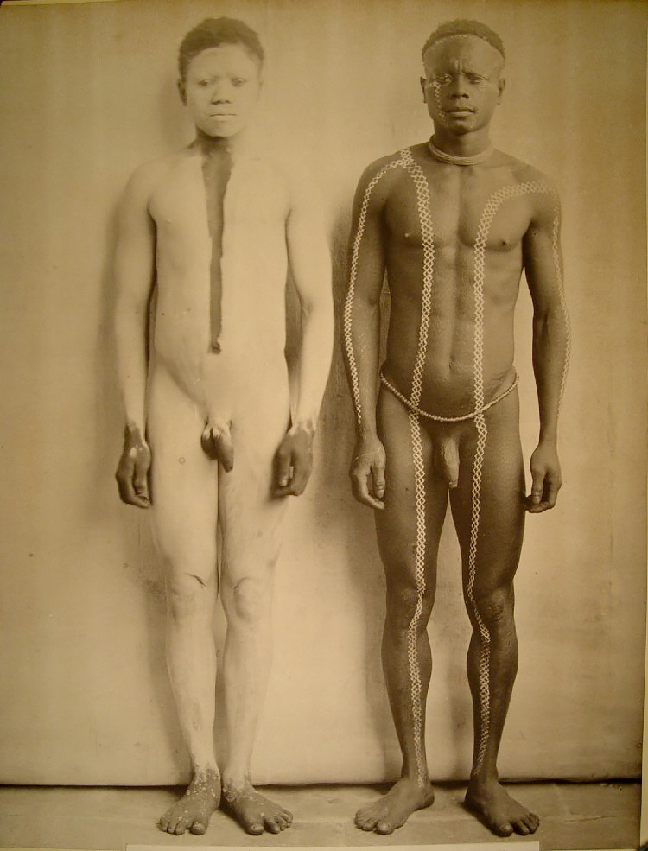
THE PICTURES FROM THE COLONIES
In the beginning the first picture taken of naked mans and women were by natives and tribal population discovered during the imperialism period
These photos were published on prestigious journals like National Geographic and were the only nude picture that could be published

Slide 7
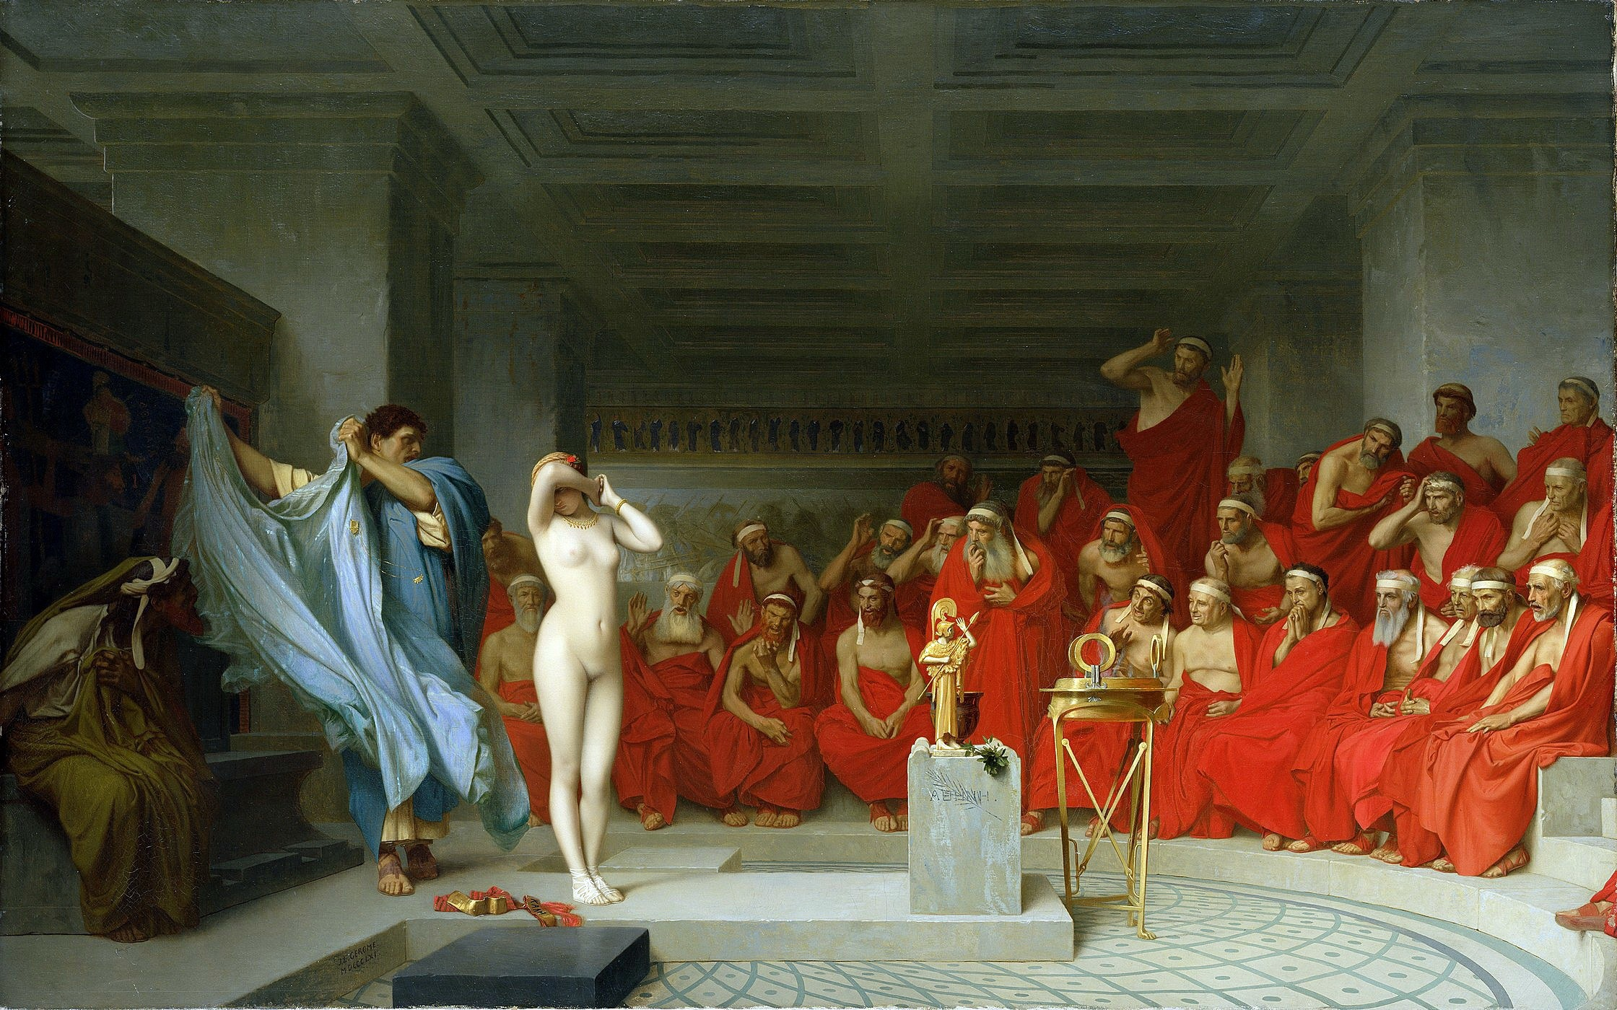
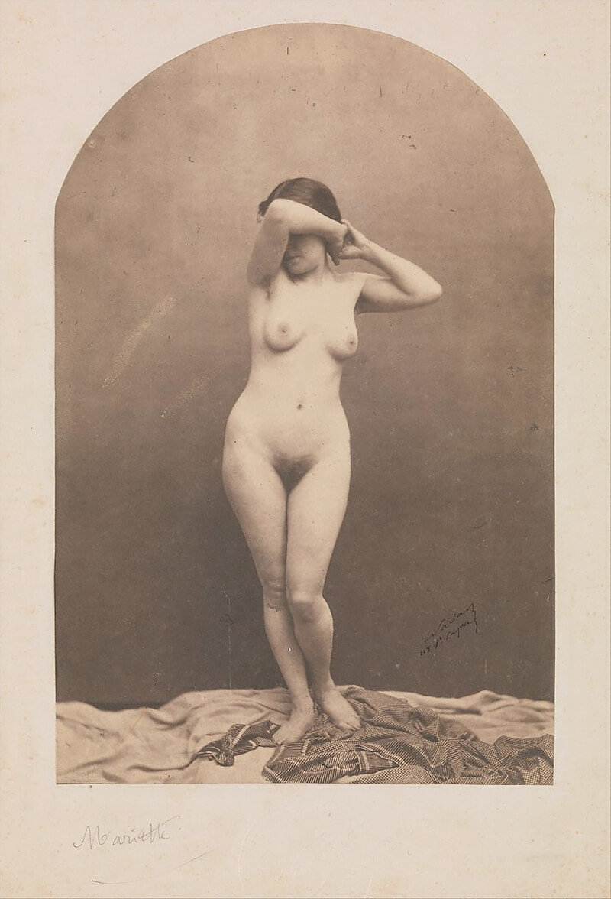
MODELS FOR ARTISTS
Later on the photography was used to create models for painters to take references
Jean-Léon Gérôme, Phryné before the Areopagus

Slide 8
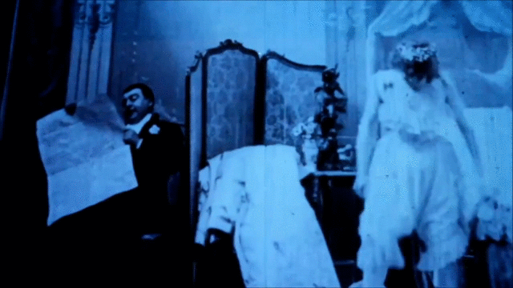
FIRST EROTIC VIDEO: 1896
“Le Coucher De La Mariée”, Eugène Pirou

Slide 9
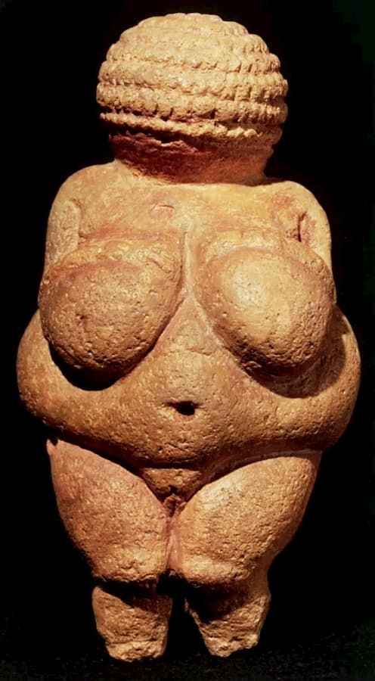
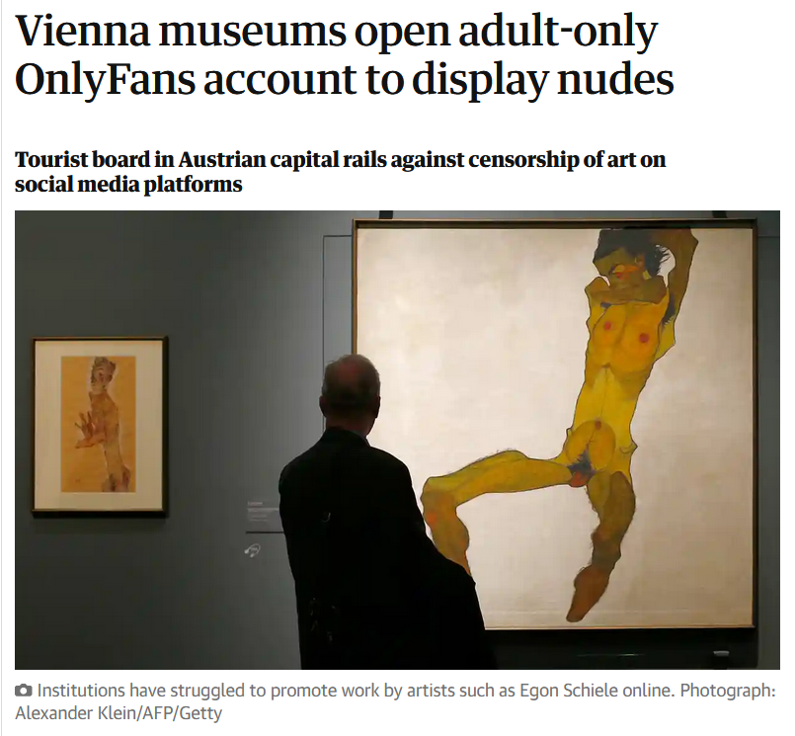
The ignorance of AI:
the inability of recognising art
Venus of Willendorf, 24000-22000 b.C.

Slide 10
SOURCES:
A brief story of nude photography 1839-1939
Mariette ~ 1860-61 – costume cocktail
Julien Vallou de Villeneuve | [Reclining Nude] | The Metropolitan Museum of Art
pornography | Definition, History, Meaning, & Facts | Britannica
Le Coucher de la Mariée 1896
Le Coucher de la Mariée - Wikipedia
Old porn pictures1850-1920
Eroticism - Wikipedia
Erotic photography - Wikipedia
Pornography - Wikipedia
The Guardian - Vienna museums open adult-only OnlyFans account to display nudes
Vienna OnlyFans
WARNING:
The sources may contain pornographic images

